Slide 1








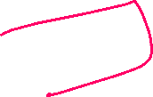
Programming for Engineers
BEP2073
>> Slide 8.1
>> Data Science (Part 2)
Machine Learning and Artificial Intelligence

Slide 2
Course Learning Outcome
CLO1 | Outline the operational procedure of programming language.
CLO2 | Outline the object-oriented attribute in the programming flow.
CLO3 | Evaluate the program structure on function, branching and condition.
CLO4 | Develop a programming/syntax solution for chemical engineering case study.
CLO5 | Differentiate between solution error and syntax error for complex engineering case study

Slide 3
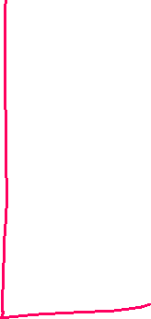

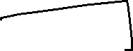



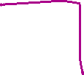




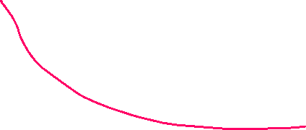


Slide 4
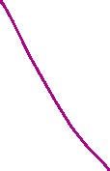
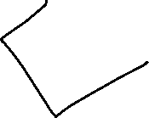

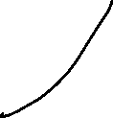
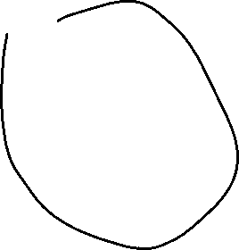
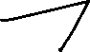
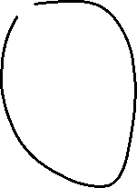
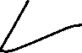
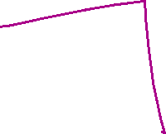
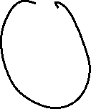

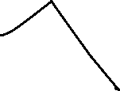





Slide 5
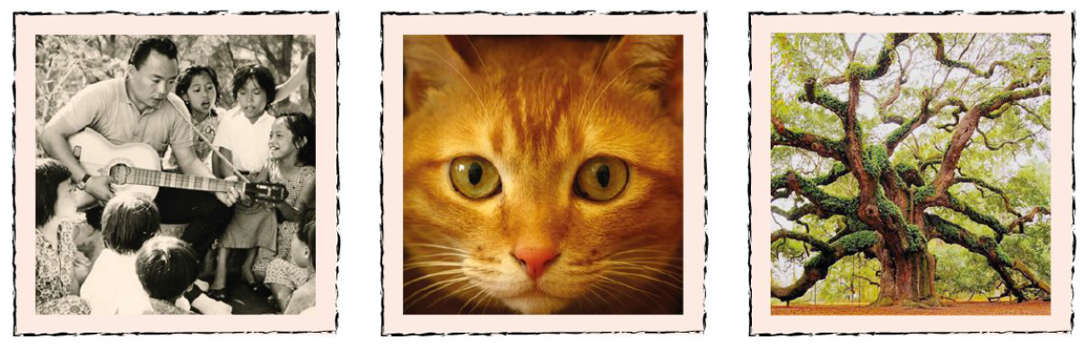








Easy for Me, Hard for You
Algorithm and formulation
Computer are VERY fast at doing arithmetic. Adding up numbers really quickly thousands, or even millions, a second may be impressive but it ISN’T artificial intelligence.
We don’t often get it wrong. In fact we can do it rather quickly, and to a very high degree of accuracy.

Slide 6
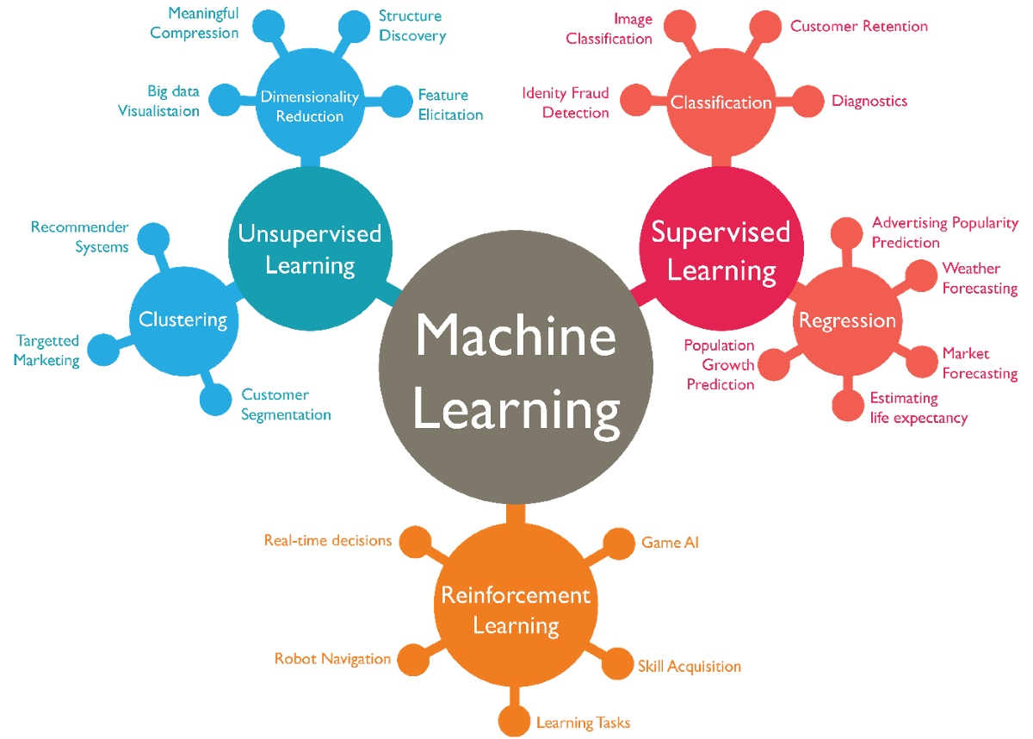




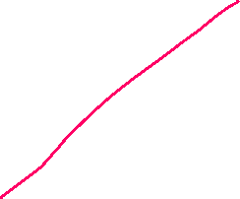

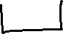
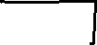

https://towardsdatascience.com/machine-learning-types-2-c1291d4f04b1

Slide 7
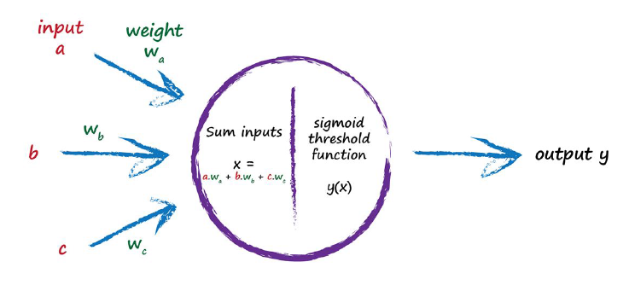





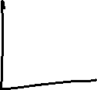
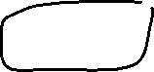

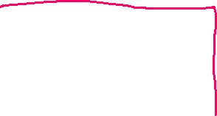
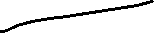

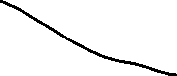
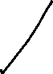
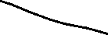
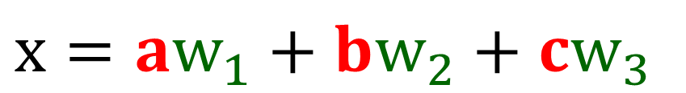
Artificial Neuron Calculation
$$x=aw_{1}+bw_{2}+cw_{3}$$
Notes:
Are we able to adjust the strength of the connections between nodes??
A low weight will deemphasise a signal, and a high weight will amplify it.
The weight enable us to have variable node (neuron)
This is more interesting!!!

Slide 8
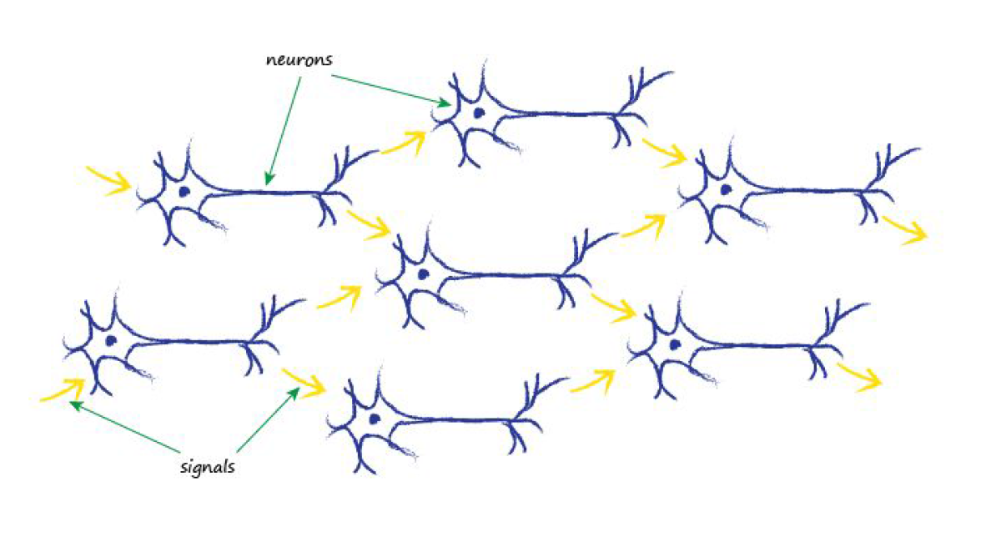
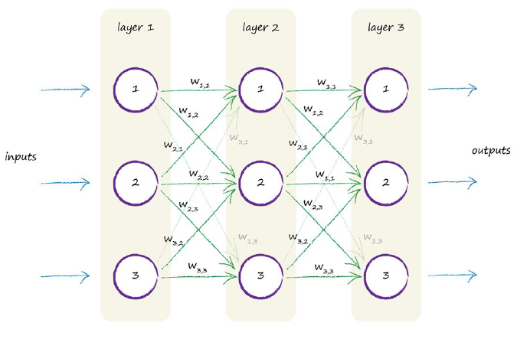
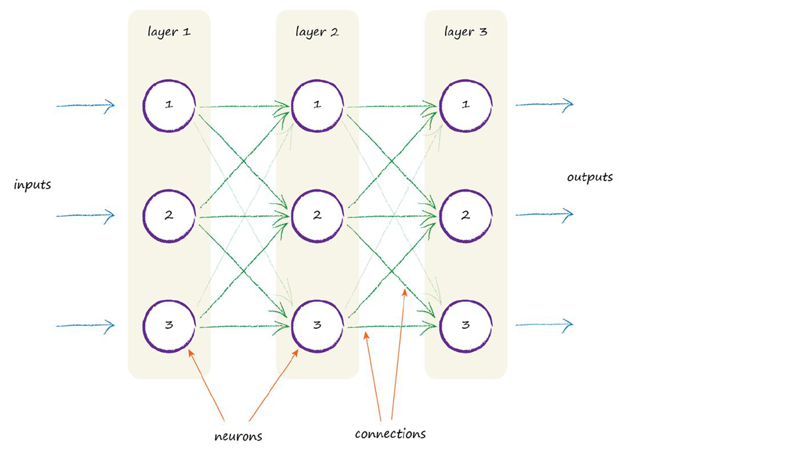
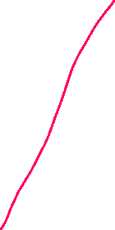

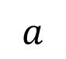


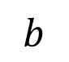


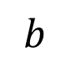
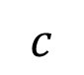
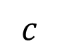
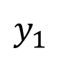
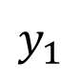
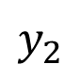

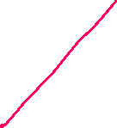
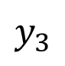
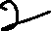


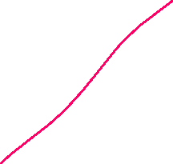
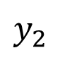
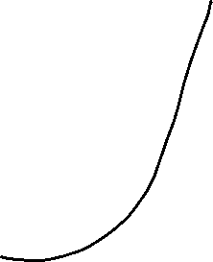
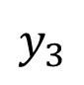



Artificial Neural Network
input
Layer 1
Layer 2
input
Layer 1
Layer 2
$$y_{1}$$
$$a$$
$$a$$
$$y_{1}$$
$$b$$
$$y_{2}$$
$$b$$
$$y_{2}$$
$$c$$
$$y_{3}$$
$$c$$
$$y_{3}$$
Notes:
The weight w 2,3 is simply the weight associated with the signal that passed between node 2 in a layer to node 3 in the next layer.
So w 1,2 is the weight that diminishes or amplifies the signal between node 1 and node 2 in the next layer.

Slide 9
Machine Learning Optimiser Algorithm
Adadelta: Optimizer that implements the Adadelta algorithm.
Adagrad: Optimizer that implements the Adagrad algorithm.
Adam: Optimizer that implements the Adam algorithm.
Adamax: Optimizer that implements the Adamax algorithm.
Ftrl: Optimizer that implements the FTRL algorithm.
Nadam: Optimizer that implements the NAdam algorithm.
Optimizer: Base class for Keras optimizers.
RMSprop: Optimizer that implements the RMSprop algorithm.
SGD: Gradient descent (with momentum) optimizer.
https://www.tensorflow.org/api_docs/python/tf/keras/optimizers

Slide 10


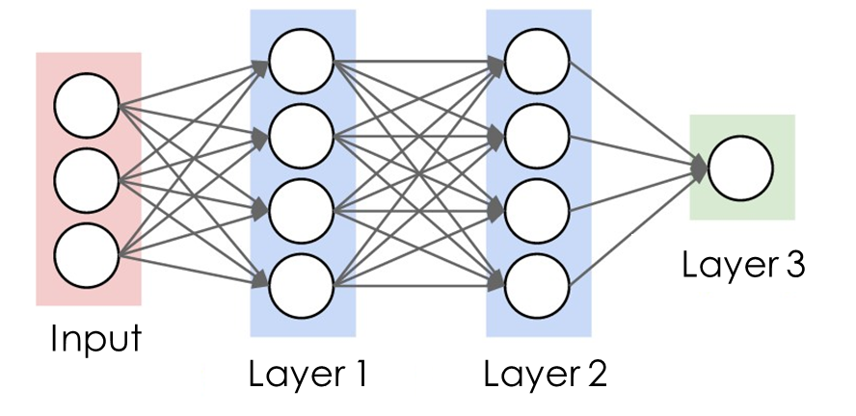
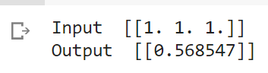












Call model on a test input
X1 = 1
y = ?
X2 = 1
X3 = 1
# Call model on a test input
x = tf.ones([1,3])
y = layer3(layer2(layer1(x)))

Slide 11













Create Model
X1 = 1
y = ?
X2 = 1
X3 = 1
import tensorflow as tf
from tensorflow import keras
from tensorflow.keras import layers
# Define Sequential model with 3 layers
model = keras.Sequential(
[
layers.Dense(4, activation=" sigmoid”, name="layer1"),
layers.Dense(4, activation=" sigmoid", name="layer2"),
layers.Dense(1, name="layer3"),
])
# Call model on a test input
x = tf.ones([1,3])
y = model(x)
# View Model structure
model.summary()
https://keras.io/guides/sequential_model/

Slide 12







Prepare dataset
$$y=\frac{a}{x_{0}}+bx_{1}^{2}+cx_{2}+d$$
Dataset
Explore
Develop model
Train Model
Validate
#Data set
def modelData(x0,x1,x2):
theta = 3 * np.random.rand(4,1)
# y = a/x + bx^2 + cx + d
return theta[0]/x0 + theta[1]*x1**2 + theta[2]*x2 + theta[3]
# Prepare the dummy dataset, X and y
X = 2 * np.random.rand(100,3)
x0,x1,x2 = X[:,0],X[:,1],X[:,2]
y = modelData(x0,x1,x2) + np.random.randn(100,3)
data = np.vstack((x0,x1,x2,y))
dataset = pd.DataFrame(data.T, columns=['x0','x1','x2','y'])
train_dataset = dataset.sample(frac = 0.8,random_state = 0)
test_dataset = dataset.drop(train_dataset.index)

Slide 13

Explore

Slide 14



Explore
Dataset
Explore
Develop model
Train Model
Validate
# Explore data
sns.pairplot(train_dataset[['x0', 'x1','x2','y']], diag_kind='kde')
train_dataset.describe().transpose()

Slide 15

Explore
Dataset
Explore
Develop model
Train Model
Validate

Slide 16






Extract features
Dataset
Explore
Develop model
Train Model
Validate
# Extract features
train_features = train_dataset.copy()
test_features = test_dataset.copy()
train_labels = train_features.pop('y')
test_labels = test_features.pop('y')
normalizer = preprocessing.Normalization(axis = -1)
normalizer.adapt(np.array(train_features))

Slide 17

Create ANN Model
Dataset
Explore
Develop model
Train Model
Validate
# Create model
model = keras.Sequential([
layers.Dense(4, activation='relu'),
layers.Dense(4, activation='relu'),
layers.Dense(1)])

Slide 18

Train model
Dataset
Explore
Develop model
Train Model
Validate
# Train ANN model by using Gradient Decent Algorithm, SGD
model.compile(loss = 'mean_absolute_error', optimizer = tf.keras.optimizers.SGD(learning_rate = 0.01))
input = train_features #3 inputs
target = train_labels
hist = model.fit(input, target, validation_split = 0.2, verbose = 0, epochs = 500)

Slide 19


Train model
Dataset
Explore
Develop model
Train Model
Validate
plt.plot(hist.history['loss'], label = 'loss')
plt.plot(hist.history['val_loss'], label ='val_loss')
plt.xlabel('Epoch')
plt.ylabel('MAE')
plt.legend()
plt.grid()
model.summary()
model.weights

Slide 20









Comparison of Learning Algorithm
Dataset
Explore
Develop model
Train Model
Validate

Slide 21



Performance
# Test
# by using Test Dataset
test_input = test_features
test_target = test_labels
# Evaluate Multi Model
test_prediction = model.predict(test_input).flatten()
# Calculate R2 by using Tensorflow add-on
metric = tfa.metrics.r_square.RSquare()
metric.update_state(test_target,test_prediction)
result = metric.result()
print('R2 = ',result.numpy())

Slide 22

Performance
# Display
a = plt.axes(aspect = 'equal')
plt.scatter(test_labels, test_prediction)
plt.xlabel('True Values')
plt.ylabel('Predictions')
lims = [0, 25]
plt.xlim(lims)
plt.ylim(lims)
plt.plot(lims, lims)
plt.title('R2 = ' + str(result.numpy()))

Slide 23


























Single Neuron
$$x=aw_{1}+bw_{2}+cw_{3}$$

Slide 24
























$$x=aw_{1}+bw_{2}+cw_{3}$$
$$a$$
$$b$$
$$c$$
model.layers[0].weights

Slide 25




















https://towardsdatascience.com/machine-learning-types-2-c1291d4f04b1

Slide 26



Case Study: Apply Lifecycle of Data science
Find Useful Insight based on the Used Car Data set as below
Link: https://www.kaggle.com/adityadesai13/used-car-dataset-ford-and-mercedes/tasks?taskId=1258

Slide 27

model
year
transmission
mileage
fuelType
tax
mpg
engineSize
price

Slide 28
End

